Slide 1
DATA MINING

Slide 2
Topics:
  J.Han, Y.Fu. “Exploration of the power of attribute-oriented induction in data mining, Advances in Knowledge Discovery and Data Mining, 1996
  S.Chaudhuri and U.Dayal. “ An overview of datawarehousing and OLAP technology, ACM SIGMOD Record 26, 1997

Slide 3
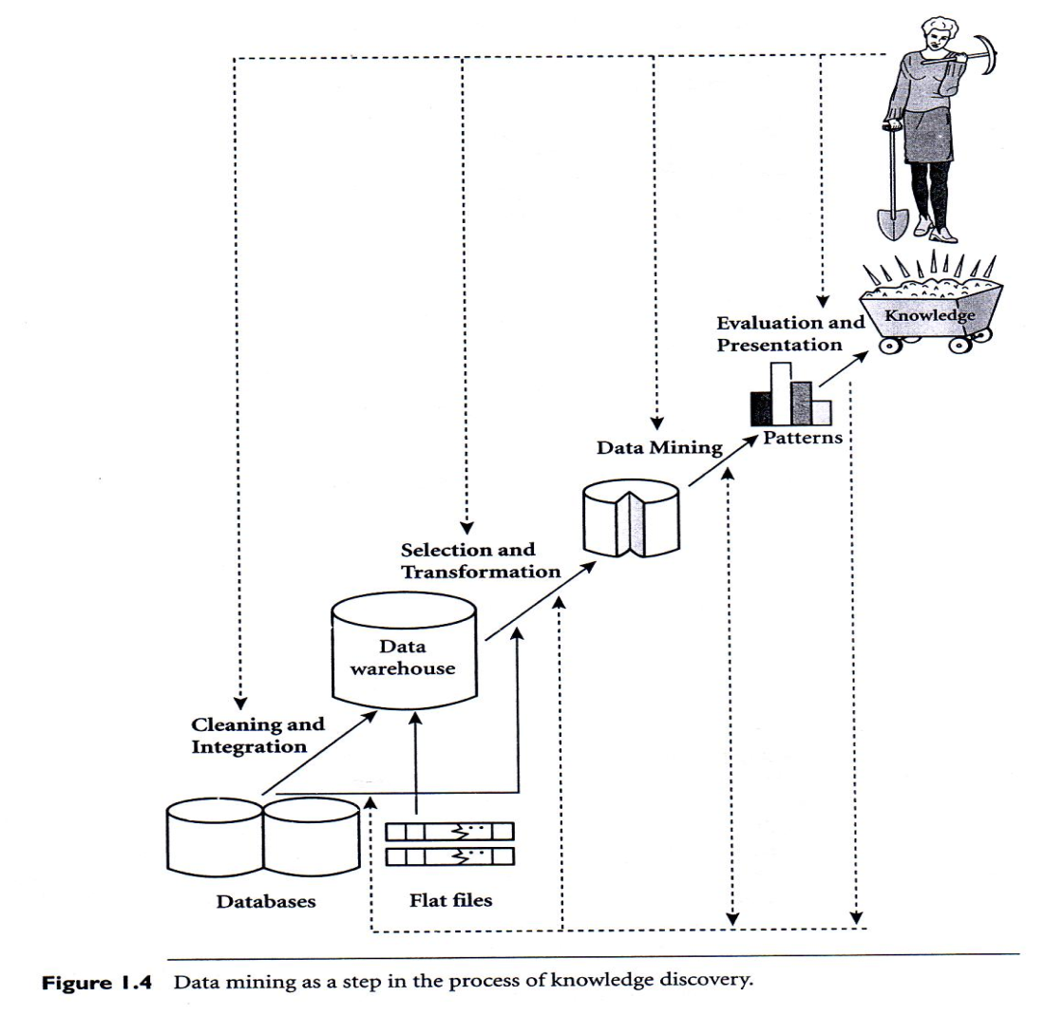
Real World
Modelling
(logical & Physical)
Domain
Aplikasi
Logical scheme (User’s view, Semantic comp.)
Physical Scheme (performance)
Query Language
Security (disaster, privacy)
Distributed Access & Data
→ Machine

Slide 4
Datawarehouse :
  Menampilkan pola “FENOMENA” berangkat dari pengalaman (DATA)
Data Mining :
  Menampilkan HASIL ANALISIS (yang selanjutnya disebut sebagai KNOWLEDGE), berangkat dari DATA, serta berbagai aturan analisis

Slide 5
PRIMITIF DATAMINING
DATA as source of analysis
  Minable view
    BUYER, PRODUK
KNOWLEDGE to be mined
  Variabel dan keterkaitannya
    INCOME vs PRODUK
    USIA vs PRODUK

Slide 6
Background knowledge
  Concept hierarchies
    PRODUK, KATEGORI PRODUK
    Buyer, Locations
MEASUREMENT
  Batasan “pola”
    % OF POPULATION
VISUALIZATION
  Tabel, charts, etc.

Slide 7
QUERY LANGUAGE
Syntaks untuk mengekspressikan :
  DATA coverage
  KNOWLEDGE
  BACKGROUND
  MEASUREMENT
  VISUALIZATION
  Contoh : DMQL (data Mining Query Language), hal. 161, DM Concept & Techniques, Jiawei Han & Micheline Kamber

Slide 8
LATIHAN
Latihan menggunakan DM System (pilih, bebas), dengan query language, al.:
1. ORACLE
2. DBMiner (OSS)
Ref. : J. Han ... Etc., Data Mining, sub bab 4.2.

Slide 9
Data Mining Functionalities /
Data Mining Tasks
Concepts/Class Description
Association
Classification
Clustering

Slide 10
Mining
Concept/Class Description
Objective
It describes a given set of data in a concise and summarative manner, presenting interesting general properties of the data
➔ data generalisation
➔ Characterization & Comparison

Slide 11
Data Generalisation-Based Characterisation
Example:
  Summer season sales Strategy
  -> item_ID, name, brand, category, supplier, price
  Summarising a large set of items relating to Summer season
Abstract a large set of data in database from relatively low-conceptual level to higher-conceptual level

Slide 12
Method/Approach:
Attribute-Oriented Induction
General Process:
→ collect the task relevant data
→ perform generalization based on the examination of the distinct values

Slide 13
Attribute removal:
→ there is no generalization operator, OR
→ its higher-level concepts are expressed in terms of other attributes
Attribute generalization
→ there exists a set of generalisation operators on attribute

Slide 14
Problems/Issue
how large ‘ a large set of distinct values for an attribute’ is considered
→ attribute generalisation threshold
if the number of distinc value in attribute is greater than the threshold, then further
att.removal or generalisation should be performed

Slide 15
generalisation relation threshold
sets threshold for the generalisation relation.
if the number of distinct value greater than the threshold, further generalisation should be performed. Otherwise, no generalisation should be performed
→ drilling down, rolling up

Slide 16
Specifying attributes, too many or too small
→ measure of attribute relevance analysis
→ to identify irrelevant or weakly relevant attributes that can be excluded from concept description process.

Slide 17
Comparaison: Discriminating Between Different Classes
It mines descriptions that distinguish a target class from its contrasting classes
General process:
→ generalisation is performed synchronously among all the class compared

Slide 18
Basic Technique
Decision Tree Induction
→ internal node
→ branch
→ leaf node
Algorithm: ID3, C45

Slide 19
Decision tree (rule) as
Classifier

Slide 20
Decision Tree
It is logic model
  Based on expression that are evaluated as true or false
  Applying Boolean & comparative operators to the feature values
It is supervised learning method
  i.e construct decision tree from a set of input-output samples
  Adopt a top-down strategy which searches for a solution in a part of solution space

Slide 21
It consists of:
  Nodes: testing attributes
  Branches: correspond to all possible outcomes of the test at the node.
Example:
X>1
Yes
No
Y=?
Y=A
Y=B
Y=C
Class1
Class2
Class2
Class1

Slide 22
Ex. ID3 and C4.5
Employ greedy search methods and involving growing & pruning decision-tree structures
  start with all samples at the root node
  Partition the samples by choosing an attribute
  Create branch → child node
  Move all ‘correct’ samples to new child node
Attribute selection:
  Based on minimizing entropy measures

Slide 23
C4.5 Algorithm
It generates an initial decision tree from the set of training samples
Two types of node:
  A leaf: indicating class
  Decision node: specify some test to be carried out on a single-attribute value
    One branch & subtree for each possible outcome
Method of selecting
  Gain criterion:
    Selects a test X to maximixe Gain (X)

Slide 24
Gain (x1) : Gain (x2) : Gain (x3) =
  0.264 : 0.048 : 0.103
  → select attribute 1 for the first splitting
  → initial tree
After initial splitting, every child node has several samples from database

Slide 25
Test x1:
Attr1 = ?
T1
T2
T3
True CLASS1
90 True CLASS2
False CLASS2
False CLASS2
70 False CLASS1
True CLASS1
False CLASS1
True CLASS1
75 True CLASS1
True CLASS2
True CLASS2
False CLASS1
80 False CLASS1
96 False CLASS1

Slide 26
For T2: leaf node
For T1
  An optimal test: attr2 <= 70, attr2 > 70
  Two branches resulting in leaf nodes
For T3
  Optimal test: attr3 = True, attr3 = False

Slide 27
X1:
Attr.1
A
C
X3:
Attr.2
B
X4:
Attr.3
<=70
>70
True
False
CLASS1
CLASS2
CLASS1
CLASS2
CLASS1

Slide 28
Model Overfitting
Training errors vs Generalization errors
  Training error: number of misclassed errors committed on training records
  Generalization errors: expected errors of the model on previously unseen records
Model that fit the training data too well
  → poorer generalization error
  → higher training error vs higher generalization error

Slide 29
Overfitting due to noise
Temperature
warm
cold
Birth?
Non-mamals
Y
N
4 legged
Non-mamals
Y
N
Mamals
Non-mamals

Slide 30
Overfitting Lack Samples
Temperature
warm
cold
Hibernate
Non-mamals
Y
N
4 legged
Non-mamals
Y
N
Mamals
Non-mamals

Slide 31
Performance Evaluation
Performance of the model on test set
Class label of test set must be known
Holdout Method:
  Divide original data into two set
  Accuracy is estimated on test set
Random Subsampling
  Repeat Holdout method
Bootstrap
  Training records are sampled with replacement

Slide 32
Classification vs Classifier
Classification: process of assigning a discrete label value (class) to an unlabeled records
Classifier: a model that predicts one attribute –class of a sample- when the other attributes are given
Result?
Most classification methods→based on inductive-learning algorithm

Slide 33
ASSOCIATION RULE
Relationship antara concept / class
komputer → sw
support = n %
Confidence = m %
Support : transaksi (komp + Sw) adalah n % dari semua transaksi
Confidence : m % pembeli komputer, juga membeli sw

Slide 34
Boolean association rule &
Single dimensional ass. rule
Transaksi
Komputer
Komp + SW

Slide 35
Quantitative association rule &
multi dimensional ass. Rule :
Usia (X, “20 – 30”) and THP (X, “5 – 10 jt”) → Beli (X, ipod MP3)
USIA
THP
Usia 20-30
THP 5-10 jt
IPOD MP3
BELI

Slide 36
Assoc. Rule :
1. Single dimensional → Apriori ALg dengan candidate gen.
tanpa candidate gen.
2. Multi dimensional → static discretization of Quant. Attr.
Distance Based ass. Rule
Assoc. rule :
1. Boolean (ya / tidak)
2. Quantitative (ref. value)
Apriori Alg. :
Scan seluruh data, untuk mengetahui support dari setiap kombinasi
Yang mungkin terjadi. (mis. : items dalam transaksi).

Slide 37
TUGAS (Studi literatur)
Mempelajari algoritma untuk :
Single dimensional Ass. Rule
Multi dimensional Ass. Rule
(kecuali dari yang ada di buku JH)
Catatan :
Diserahkan dalam bentuk makalah

Slide 38
CLASSIFICATION RULE
Predict a [set] class of data
Prediction : predict future trend of class.
Classification Algo. : decision tree induction, Bayesian Classi. Bayesian Belief Network, Neural net., k-nearest neighbor classifiers, case based reasoning, genetic algo., rought set, fuzzy logic, etc.

Slide 39
Step in Classification
Predict a model (set of class), menggunakan class label attribute dari “training data”.
(N1, 31, low, poor)
(N2, 35, fair, fair)
(N3, 40, fair, excellent)
etc……
Class Label attr. → Usia dan Income
Model → Credit rating.
Class. Rule : → (30---40), fair, fair)

Slide 40
Quality of Classification
Ql of model, dilihat dari sisi training data
    Confidence like ?
Ql. Of model, dilihat dari sisi test data.
    Accuracy of model → confidence measurement.

Slide 41
PREDICTION
Classifier dapat digunakan sebagai “prediction”. Memprediksi trend dari model.
Prediksi : Turun / naik dengan berubahnya waktu (fungsi waktu)

Slide 42
Training
data
PROCESS
Menentukan
Classification
Classifications
Support
Confidence
PROCESS
Identifikasi
Classification
Ref :
- Class Label Attribute
- Conditions
Data baru

Slide 43
CLUSTERING
Menentukan category of class, berdasarkan kemiripan object
Cluster : kumpulan object yang mempunyai kesamaan (similarity), dan berbeda dengan cluster yang lain (disimilarity).
Disimilarity “diukur” berdasarkan “jarak”

Slide 44
PROCESS CLUSTERING
Menentukan Cluster
Menentukan Karakteristik
usia
rating
Low
Fair
Good

Slide 45
ERRORS
Error dari sisi data (noisy data) :
    Missing value : undefined data
    Salary = -
    Outlier : Data relatif berbeda dari rata-rata
    Usia = 105
    Transaksi ~ berbeda dari biasanya
    → Mempengaruhi SUPPORT & CONFIDENCE

Slide 46
MISSING VALUE
Prosess :
  Identifikasi Missing value
  Menentukan value (perkiraan)
    Cenderung mengkatogorikan pada value rata-rata

Slide 47
OUTLIER
Prosess :
  Identifikasi Outlier
    Outlier value, belum tentu salah
    Outlier value, karena kesalahan data
  Eliminasi Outlier
    Cenderung merubah data jadi rata-rata

Slide 48
PROCESSING PROBLEM
SCALABILITY :
Biasanya, DM selalu diaplikasikan untuk volume data yang relatif besar (storage based processing, bukan memory based processing)
VISUALIZATION :
Khususnya untuk multi-dimensional

Slide 49
PENELITIAN
ASSOCIATION on GIS
CLUSTERING on text
CLASSIFICATION

Slide 50
Problems/Issues:
  Selecting attribute to be tested
  → attribute selection measure
  Overfitting data
  → tree pruning

Slide 51
Bayessian Classification
  it is a statistical classifier
  it can predicts class membership probabilities
  based on Bayes theorem

Slide 52
Bayessian Belief Network
Provide a graphical model of causal relationship
  Joint conditional probability distribution
  Called: bayessian network, belief network, probabilistic network
Component:
  Directed Acyclic Graph (DAG)
  Conditional Probablity Table (CPT)

Slide 53
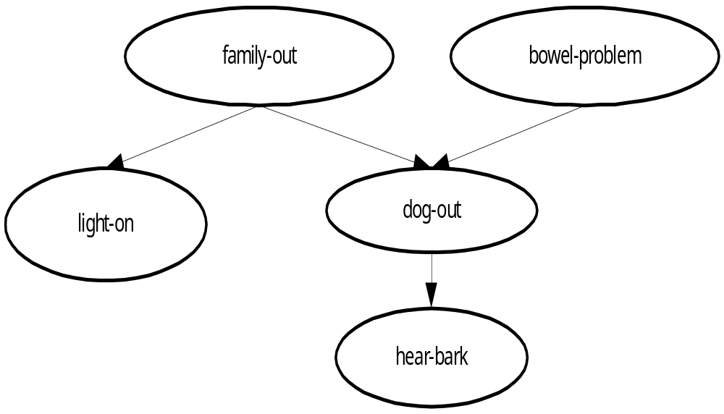

Slide 54
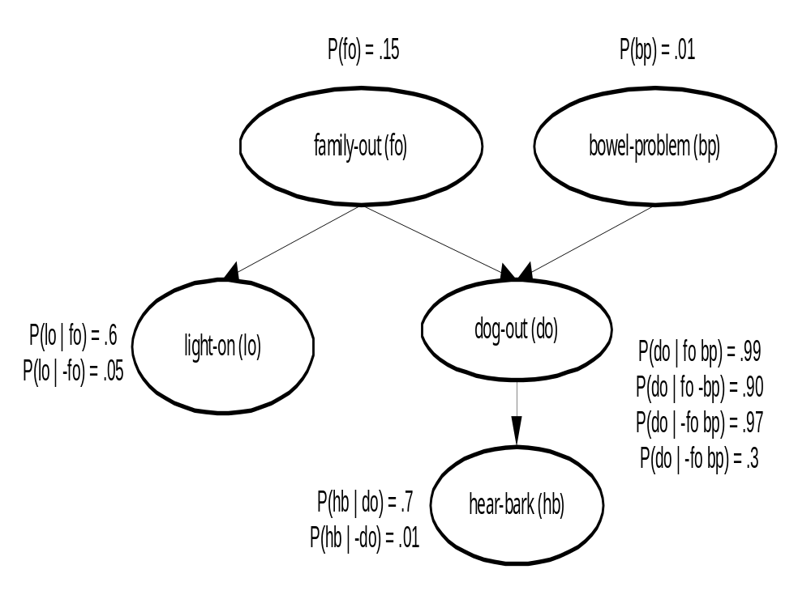

Slide 55
Prediction
It is used to predict continuous values as prediction
Approach: Regression Techniques
  Linear & Multiple Regression
  Non-linear Regression

Slide 56
Problems/Issues
Estimating Classifier Accuracy
→ effectiveness methods for estimating classifier accuracy
→ k-fold cross-validation, sensitivity, specificity

Slide 57
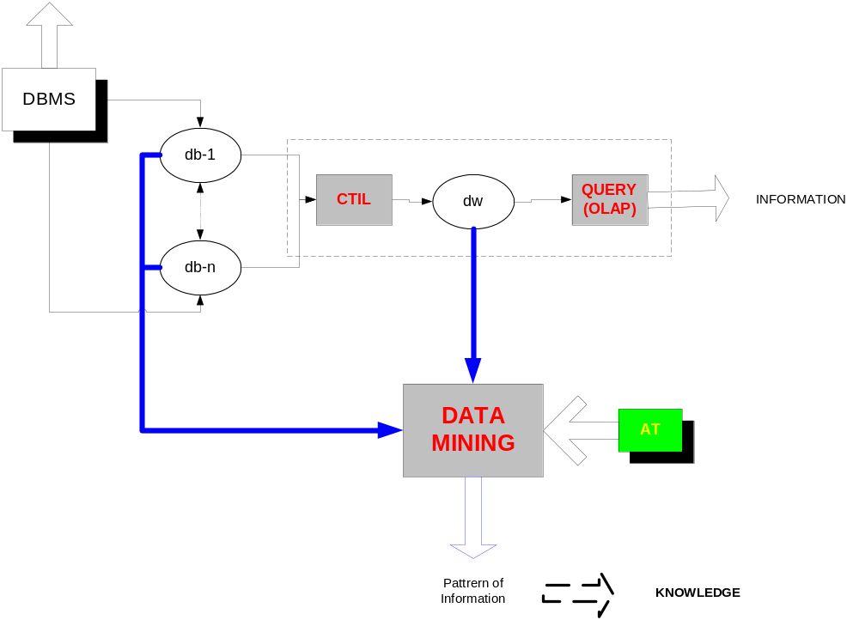
DATA WAREHOUSE & DATA MINING

Slide 58
AREA PENELITIAN (current)
Multi dimentional db (structure)
OLAP (query)
Query DM
AT (analitycal Tools)
CTIL (khususnya untuk db yang heterogen)
DW dan DM untuk format data lain (gambar, video, GIS, voice, dll.)

Slide 59
PENGELOLAAN DATA
Mencakup :
1. Pemasukan data
2. Edit / Update data
3. Akses data (by condition)
4. Penghapusan data

Slide 60
JENIS DATA
Alphanumeric (1 byte ~ 1 karakter)
  by content / sequence of bits → addresse [logic / physic]
Gambar / Image (vector / raster)
Sequence of image → video / film
Suara → Music

Slide 61
Gambar, Suara
kondisi
Converter
(sequential)
???
Seq. of bits

Slide 62
Pendekatan
Dari sudut pandang pemakai :
  Apa yang menjadi “kondisi pencarian”
  Bagaimana mengekpressikan kondisi
Dari sudut pandang komputer :
  Bagaimana mengidentifikasikan kondisi
  Bagaimana “direct access”

